Slide 1
The IR-4 Project: Lowering the Regulatory Hurdles for Biopesticides
Krista Coleman
IR-4 Project, Rutgers University
Princeton, New Jersey

Slide 2
Key Points
What is The IR-4 Project?
How does it help with regulatory issues in the United States and abroad?
Where can I find relevant information?

Slide 3
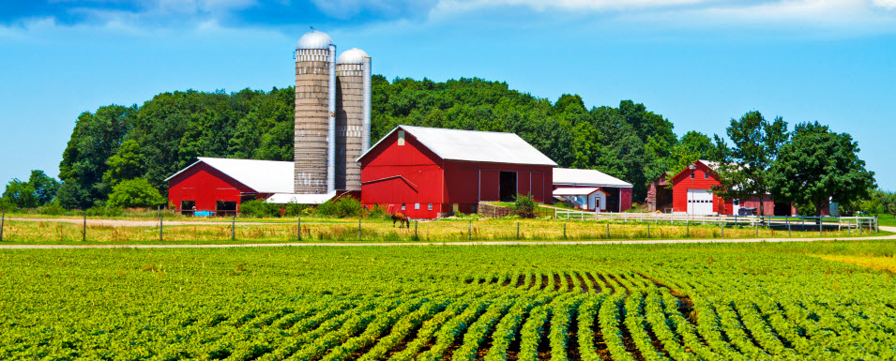
The IR-4 Project
The IR-4 (Interregional Research Project No.4) supports growers by making pest control products available for use on specialty crops
Since 1963, we have been the major resource for supplying pest management tools by developing research data to support new EPA registrations
We fill the void where Registrants don’t see an economic interest
Notes:
The Interregional Research Project No.4 was one of several Interregional Research Projects started in the early 1960s, basically a national research project. Was about 15, we’re still left.

Slide 4
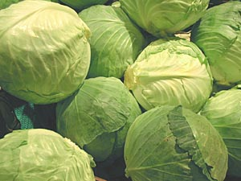
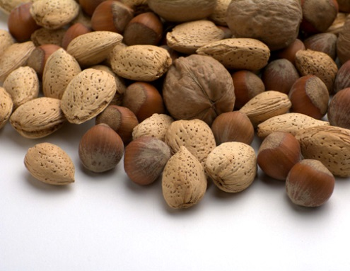
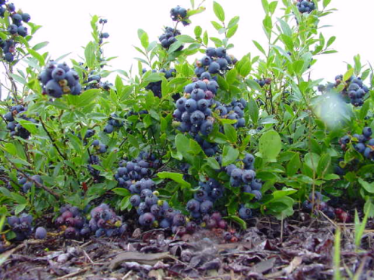
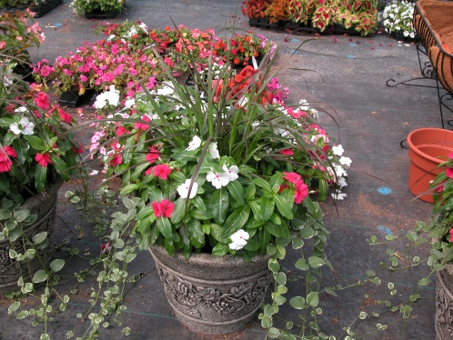
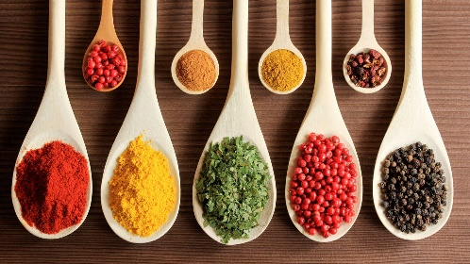
Specialty Crops
Vegetables
Fruits
Tree Nuts
Herbs & Spices
Floral
Nursery
Landscape
Turf
Christmas trees
Notes:
What do we mean by specialty crops? Here are some examples:

Slide 5
IR-4 Program Areas
Food use biopesticide & organic ORN. Hort.
Notes:
Different categories of these specialty crops and needs of the growers lead The IR-4 Project to develop three distinct program areas.

Slide 6
Research on Minor Use Pesticides
Food Use Program: PESTICIDE RESIDUE- NEW MRL’s
Lower risk products that fit IPM
Use of Crop Groups for broad labeling of specialty crops based on data from representative crops
Some efficacy data
Ornamental Program: EFFICACY- FLOWERS, WOODY,
FOLIAGE
Biopesticide Program: EFFICACY and REGISTRATION
Notes:
Overall, IR-4 helps by conducting research on minor use pesticides that would not otherwise be profitable to manufacture. Here is what each program area focuses on:
FU looking for newer products, softer on beneficials more specific sites of action.
Crop groups: submitted petition for updates
Codex: completed fruit, veg, cereal grains

Slide 7
IR-4 Biopesticide and Organic Success
BT approved for “All Crops”
Plum Pox Resistant Varieties
Codling Moth Granulosis Virus
Papaya Ring Spot Resistant Varieties
Mite management with honey bees
AF-36 (Aflatoxins)
Spinosad approved for “All Crops” Organic
And many others
Notes:
Our history on biopesticides goes back a long time, in the 1970s we submitted the request to EPA for BT approval on all crops:
France may be familiar with Plum Pox.
Biopesticide is about 10% of total IR-4 budget.

Slide 8
Lowering Regulatory Hurdles for Biopesticides
We don’t change regulatory requirements, we decrease the barriers and cost burdens
Assist biopesticide registrants
Facilitate registration of new products through the EPA
Toxicology studies
Scientific Rationale
Notes:
We decrease the barriers by helping companies prepare regulatory packages. We seek public information (scientific data/articles) to support and decrease the cost burden to register new biopesticides. Because we are in the public interest, we are exempt from tax funds, and the process to gather needs is from the public (small companies). After needs are gathered, they must go through the PMC (Project Management Committee) which is like a board of directors.

Slide 9
REGULATORY ASSISTANCE
Goal: Obtain EPA registration
Regulatory assistance for EPA registration
Receive Requests- From the Public sector for New Active Ingredients
Small companies, USDA, Universities
Arranging meetings with EPA
Writing data waiver scientific justification
Formatting documents
Government Forms
Label Modification
Communication, Negotiation
Toxicology review

Slide 10
PRIA-Fee for Service
Pesticide Registration Improvement Act
Biopesticide type | PRIA 3 June 2012
Biochemical, MicrobialProduct New AI, Food Use, Tolerance Exemption | 18 month review $28,942
Straight Chain Lepidopteran Pheromones | 7 month review $2,316
Plant Incorporated Protectant | 15 month $289,407
Notes:
The goals of this fee system are to: create a more predictable evaluation process for affected pesticide decisions, and couple the collection of individual fees with specific decision review periods. Actions subject to fees are categorized first by type of chemical, next by the type of action: New active ingredient, new use, amendments, etc. The Federal Insecticide, Fungicide, and Rodenticide Act (FIFRA) amendments passed by Congress in 2004.

Slide 11
PRIA-Fee for Service
Pesticide Registration Improvement Act
Biopesticide type | PRIA 3 June 2012
Biochemical, MicrobialProduct New AI, Food Use, Tolerance Exemption | 18 month review $28,942
Straight Chain Lepidopteran Pheromones | 7 month review $2,316
Plant Incorporated Protectant | 15 month $289,407
IR-4 Fee exemption
Notes:
Exemption from registration service fees MUST be in the public interest: Specialty crop use, representative commodity of crop group, or niche pest on a major crop, etc. IR-4 is a public entity, funded through US taxpayer funds.

Slide 12
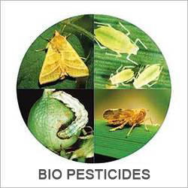
How do we help abroad?
Bringing new biopesticide technologies to U.S. growers:
Microorganisms- Fungi, Bacteria, Viruses
Biochemicals- Plant extracts, minerals, pheromones
Biotechnology- BT crops, modified plants, microorganisms, insects, RNAi, etc.
Notes:
Biotechnology is part of the same division at EPA – the Biopesticide and Pollution Prevention Division also regulates GMOs.

Slide 13
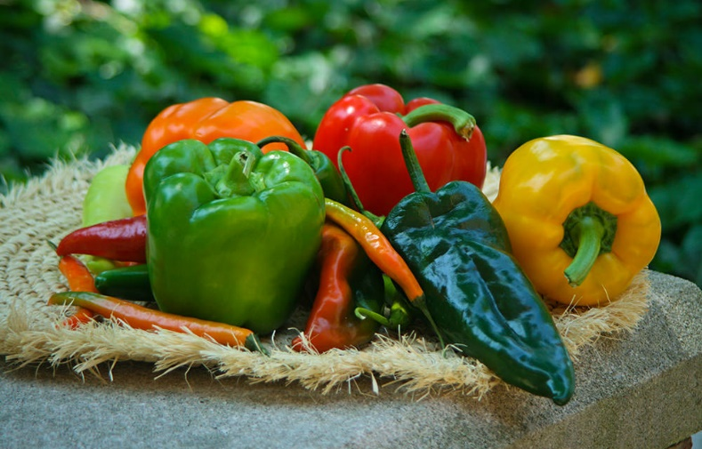
Case Studies
Notes:
Here are some case studies relating to the products from abroad.

Slide 14
Giant knotweed extract- Disease management
a.i.: Reynoutria sachalinensis
Fungicide activity discovered in Darmstadt Germany
Registered in US by IR-4 for former BASF scientist (KHH)
KHH Sold rights to Marrone BioInnovations
International distribution rights BASF
Notes:
The regulatory process is complicated, with changes in countries and companies and some rights being sold internationally

Slide 15
For management of
Dutch Elm disease
Notes:
Dutch Trig® is a vaccine-like product from the Netherlands, now registered in the U.S. to treat Dutch Elm disease.

Slide 16
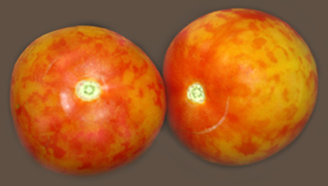
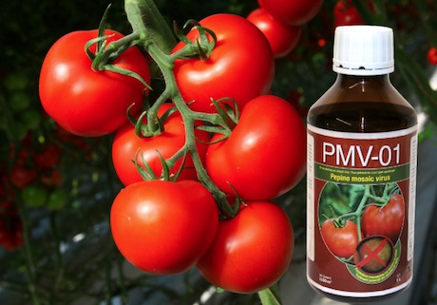
PMV-01
For Pepino Mosaic Virus on tomato
2015: 120-days emergency authorization
Now authorized for use in several European nations
http://www.pmv-01.com/
Notes:
Switzerland, France, Germany.

Slide 17
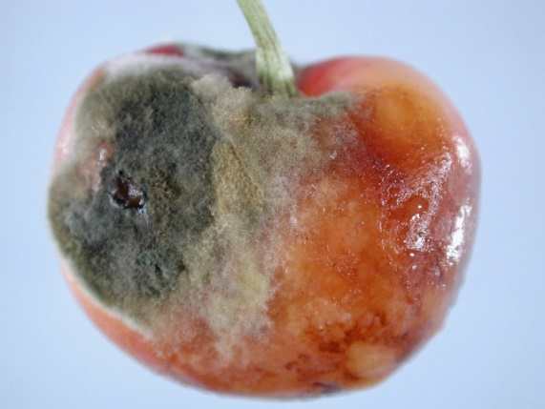
KM1110
For pre- and postharvest fruit rots
Product originally from Israel
Acquisition of rights by Bayer
Acquisition of company rights, product now in The Netherlands
Notes:
Both PMV-01 and KM1110 are currently going through the registration process in the United States. All these products exemplify the complicated global regulatory process.

Slide 18
PATH FORWARD?
Global Minor Use Summit 3 Montreal, Canada
Review and publish a list of substances exempt from MRLs (such as biopesticides and compounds of no toxicological concern)
Champions to carry the work forward: Michael Braverman (IR-4), Nina Wilson (Gowan), Leslie Farmer (AAFC-PMC), Carrie Link (Marrone Bio), David Cary (BPG), Jeroen Meeussen (EUMUCF), Pranjib Chakrabaty (India), Bakari Kaeneka (Africa)
Still need a champion from Latin America
Notes:
“AAFC-PMC= Agriculture and Agri-Food Canada Pest Management Centre” “BPG=BioProtection Global” “EUMUCF= European Union Minor Uses Coordination Facility”The Third Global Minor use Summit took place October 1-4, 2017, in Montreal, Quebec Canada. More than 220 delegates from over 35 countries where in attendance. The Canadian Agriculture and Agri-Food Canada Pest Management Centre hosted event in partnership with IR-4 and the US Department of Agriculture Foreign Agriculture Services. The participants, through a series of breakout sessions, identified seven main areas to focus ongoing work. While many of these areas, such as cooperation and communication have been reiterated from past summits, this summit requested that minor use champions be identified to carry topics forward and that a team or committee of champions meet on a regular basis to keep the momentum going.
The specific recommendations of the Summit as well as the priorities of the Workshop will be released shortly by posting at http://gmup.org. This plan was decided on by all attendees.

Slide 19
PATH FORWARD?
Global Minor Use Summit 3 Montreal, Canada
Review and publish a list of substances exempt from MRLs (such as biopesticides and compounds of no toxicological concern).
List- Database Parameters and Scope
Timelines
Regulatory harmonization component
Meet to discuss follow up
Notes:
We need to establish a timeline for the list to make sure the bar doesn’t keep climbing for biopesticides.
We encourage products and don’t infere w/ trade
OECD: Organization of Economic Cooperation and Development, smaller than Codex which is UN organization of about 60 countries

Slide 20
Where Can I Find Relevant Information?
http://ir4.rutgers.edu/biopesticides.html
Here you can submit regulatory requests. Our website also contains efficacy reports, label descriptions, pest management requests, and ongoing regulatory projects.
Notes:
If you are a US grower, scientist etc.. b/c we are publically funded, information is publically available.

Slide 21
Regulatory Assistance
From the main page, select “EPA Registration Assistance Form”
Notes:
European company would need to have a US entity and the request for IR-4’s assistance would need to come from the US public sector research, extension or grower community.

Slide 22
Regulatory Assistance
Proceed to have a member from the U.S. public sector (small business, researcher, etc.) fill out the form
Write a letter describing why the product is needed/ how it is of public interest
Supply efficacy data
Request goes through PMC for approval
Notes:
Goal is registration in the US. Generally only work with new active ingredients. Has to have a request from US growers/us science/extension. PMC= Project Management Committee

Slide 23
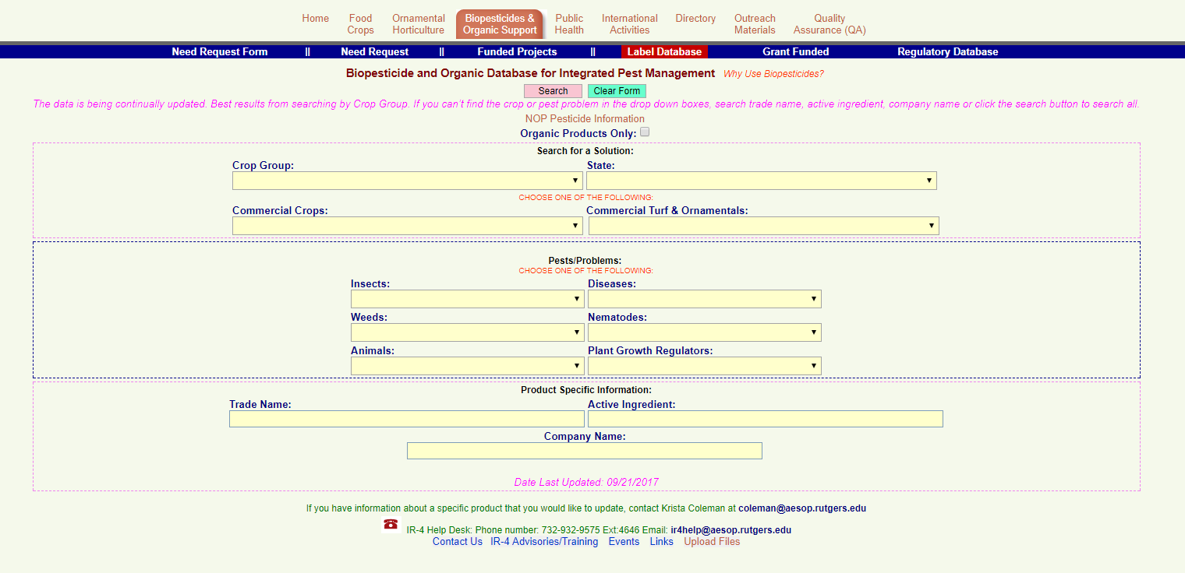
Label Database
To see existing products, you can access by the main page or using the blue navigation tab at the top of the page. Select the “Label Database.”

Slide 24
Label Database
If you would like organic products, check the “Organic Products Only” box
Searching by “Crop Group” is recommended for full results
Select “Search”

Slide 25
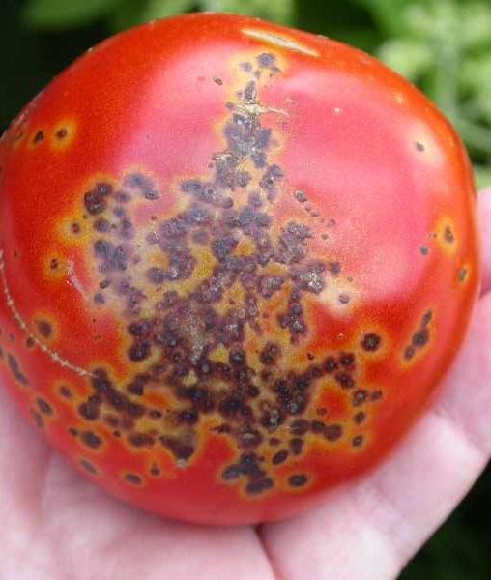
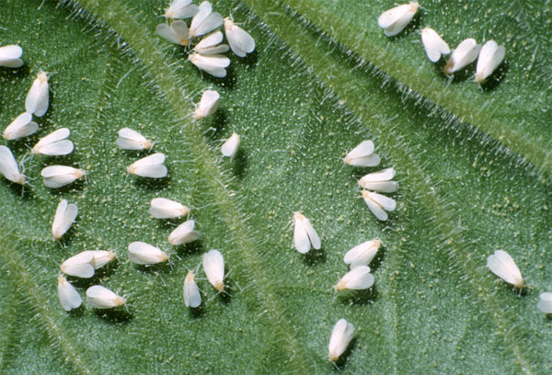
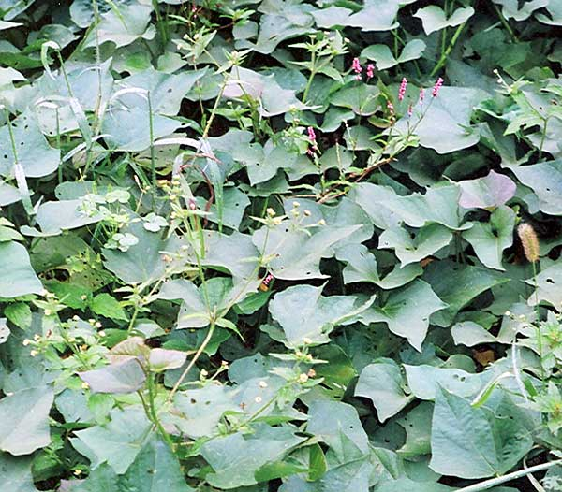
THANK YOU!
Krista Coleman
kristaco@NJAES.Rutgers.edu
Michael Braverman
mbrave@NJAES.Rutgers.edu
Bill Barney
barney@NJAES.Rutgers.edu
Jerry Baron
jbaron@NJAES.Rutgers.edu
This material is based upon work that is supported by the National Institute of Food and Agriculture, U.S. Department of Agriculture, under award number 2015-34383-23710 with substantial cooperation and support from the State Agricultural Experiment Stations, USDA-ARS and USDA-FAS In accordance with Federal Law and U.S. Department of Agriculture policy, this institution is prohibited from discriminating on the basis of race, color, national origin, sex, age or disability.

Slide 26
Frequently Asked Questions
Frequently Asked Questions
Q: How long is the regulatory process through the EPA?
A: Generally 18 to 19 months for a new active ingredient to be registered
Q: Is a biopesticide organic?
A: Not necessarily. For example, inerts must be approved organic products, Biochemicals organically produced, and microbials must have appropriate media for manufacturing. In the United States, guidelines are established by the USDA National Organic Program (NOP).

Slide 27
Frequently Asked Questions
Frequently Asked Questions
Q: How much funding does the IR-4 Biopesticide and Organic Support Program provide for efficacy research?
A: $400,000 (USD) per year. Most projects get $15,000 or less.
Q: How does “regulatory” differ from “registration?”
A: EPA’s regulatory aspect refers to the guidelines for protecting human health and the environment. Registration refers to the process of officially adding a biopesticide (pest control product) to the national list, i.e. the product as a label for use by growers.

